Slide 1
Biodiversity knowledge synthesis: an introduction to meta-analyses and systematic reviews Quantitative synthesis: the visualisations
October 2022
Beillouin Damien
Chercheur CIRAD- Hortsys

Slide 2
Aim of a meta-analysis
-> to be transparent, reproducible
-> to be easily interpretable

Slide 3
Present the data
Prisma Flow diagrams:
Gurevitch et al., 2018

Slide 4
Present the data
Maps:
Beckman et al., 2019

Slide 5
Present the results of the meta-analysis
Forest plot
RE models
-1
0
1
Log ratio of diversified to
less diversified systems

Slide 6
Present the results of the meta-analysis
Forest plot
FE models
RE models
-1
0
1
Log ratio of diversified to
less diversified systems

Slide 7
Present the results of the meta-analysis
Forest plot
Study 1
Study 2
Study 3
FE models
RE models
-1
0
1
Log ratio of diversified to
less diversified systems

Slide 8
Present the results of the meta-analysis
Forest plot
Yield less diversified systems
Yield diversified systems
#
paired data
Mean
SD
Mean
SD
Weights
Study 1. XXXX XXXX XXXX XXXX. 52. 33.1%
Study 2. XXXX XXXX XXXX XXXX. 15. 6.9%
Study 3. XXXX XXXX XXXX XXXX. 87. 60%
154
100%
FE models
RE models
-1
0
1
Log ratio of diversified to
less diversified systems

Slide 9
Present the results of the meta-analysis
Forest plot
Yield less diversified systems
Yield diversified systems
#
paired data
Mean
SD
Mean
SD
Weights
Study 1. XXXX XXXX XXXX XXXX. 52. 33.1%
Study 2. XXXX XXXX XXXX XXXX. 15. 6.9%
Study 3. XXXX XXXX XXXX XXXX. 87. 60%
154
100%
FE models
RE models
Heterogeneity : Tau² ⁼ XXXX ; Chi^{2 = XXX}; df= X (P<0.001); I²= 87%
Test for Overall effect: Z=1.44 (P=0.15)
-1
0
1
Log ratio of diversified to
less diversified systems

Slide 10
Present the results of the meta-analysis
Forest plot
Predator responses to fire:
Geary et al., 2019

Slide 11
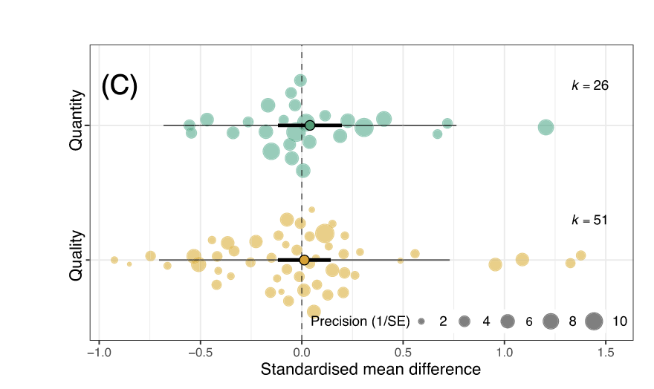
Present the results of the meta-analysis
“Orchards” plot
Nagakawa et al., 2020

Slide 12
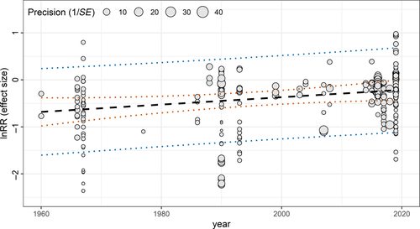
Present the results of the meta-analysis
Meta-regression:
Bishop and Nagakawa et al., 2020

Slide 13
Present the results of the meta-analysis
L’abbé plot:
Bishop and Nagakawa et al., 2020

Slide 14
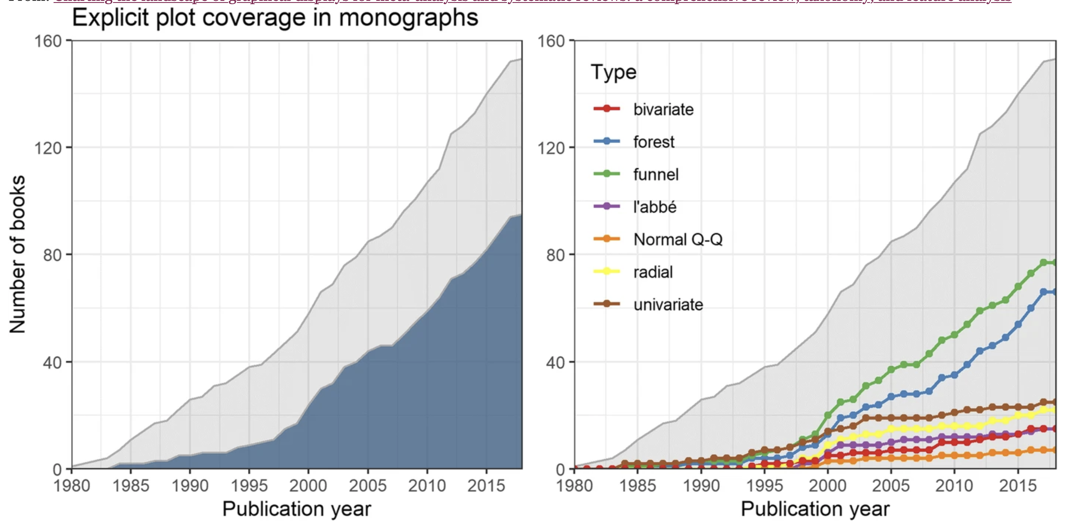
Present the results of the meta-analysis
Kossmeier et al., 2020

Slide 15
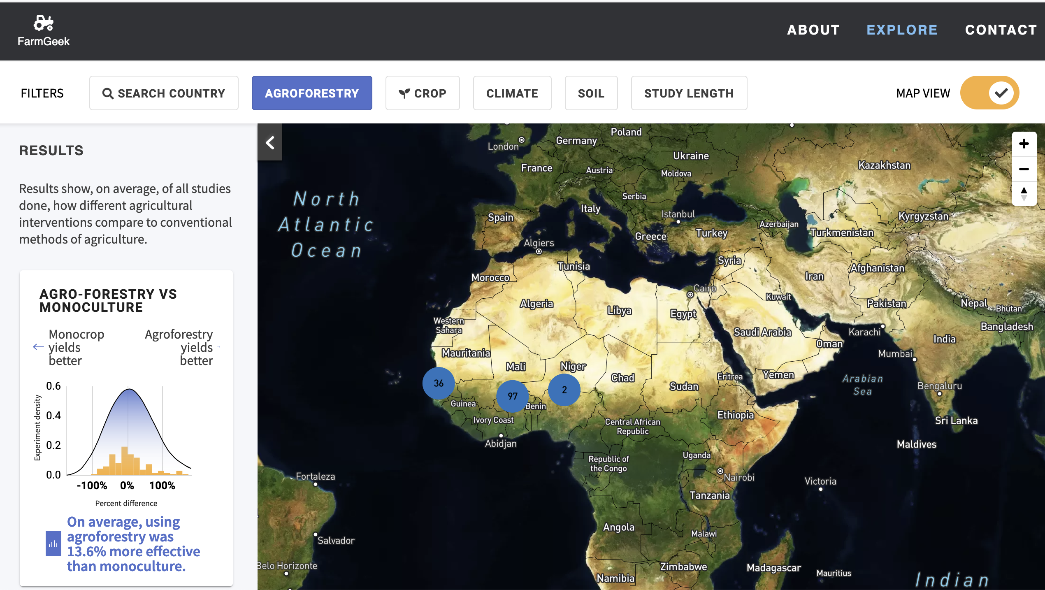
Present the results of the meta-analysis
Meta-analyses : web interfaces
https://www.farmgeek.xyz

Slide 16
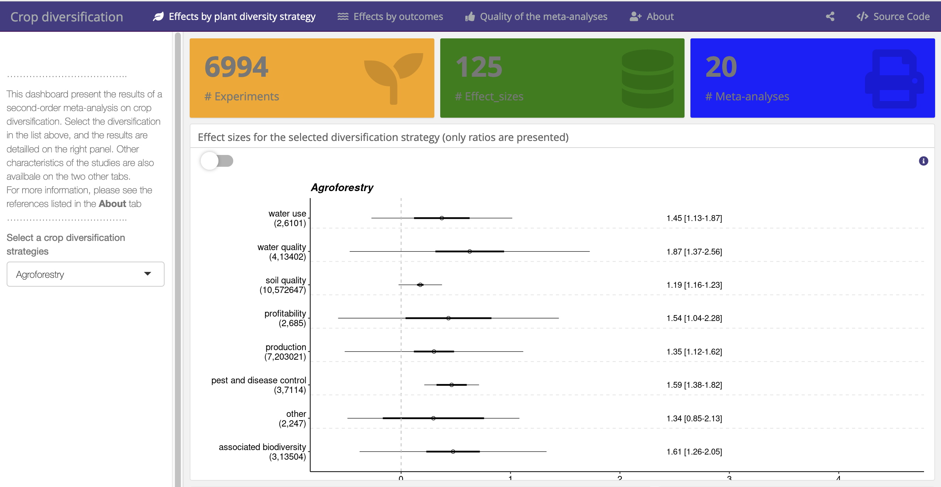
Present the results of the meta-analysis
Meta-analyses : web interfaces
https://cropdiversification.shinyapps.io

Slide 17
Present the results of the meta-analysis
Packages
metafor
ggplot2
forestplot
…
https://cropdiversification.shinyapps.io

Slide 18
Test the robustness of the results
Publication bias
https://cropdiversification.shinyapps.io

